Slide 1


Uğur
Böcekleri
Group Members:
Cem Özcan
Fırat Haşhaş
Berfin Şimşek
Ravza Nur Erkal

Slide 2
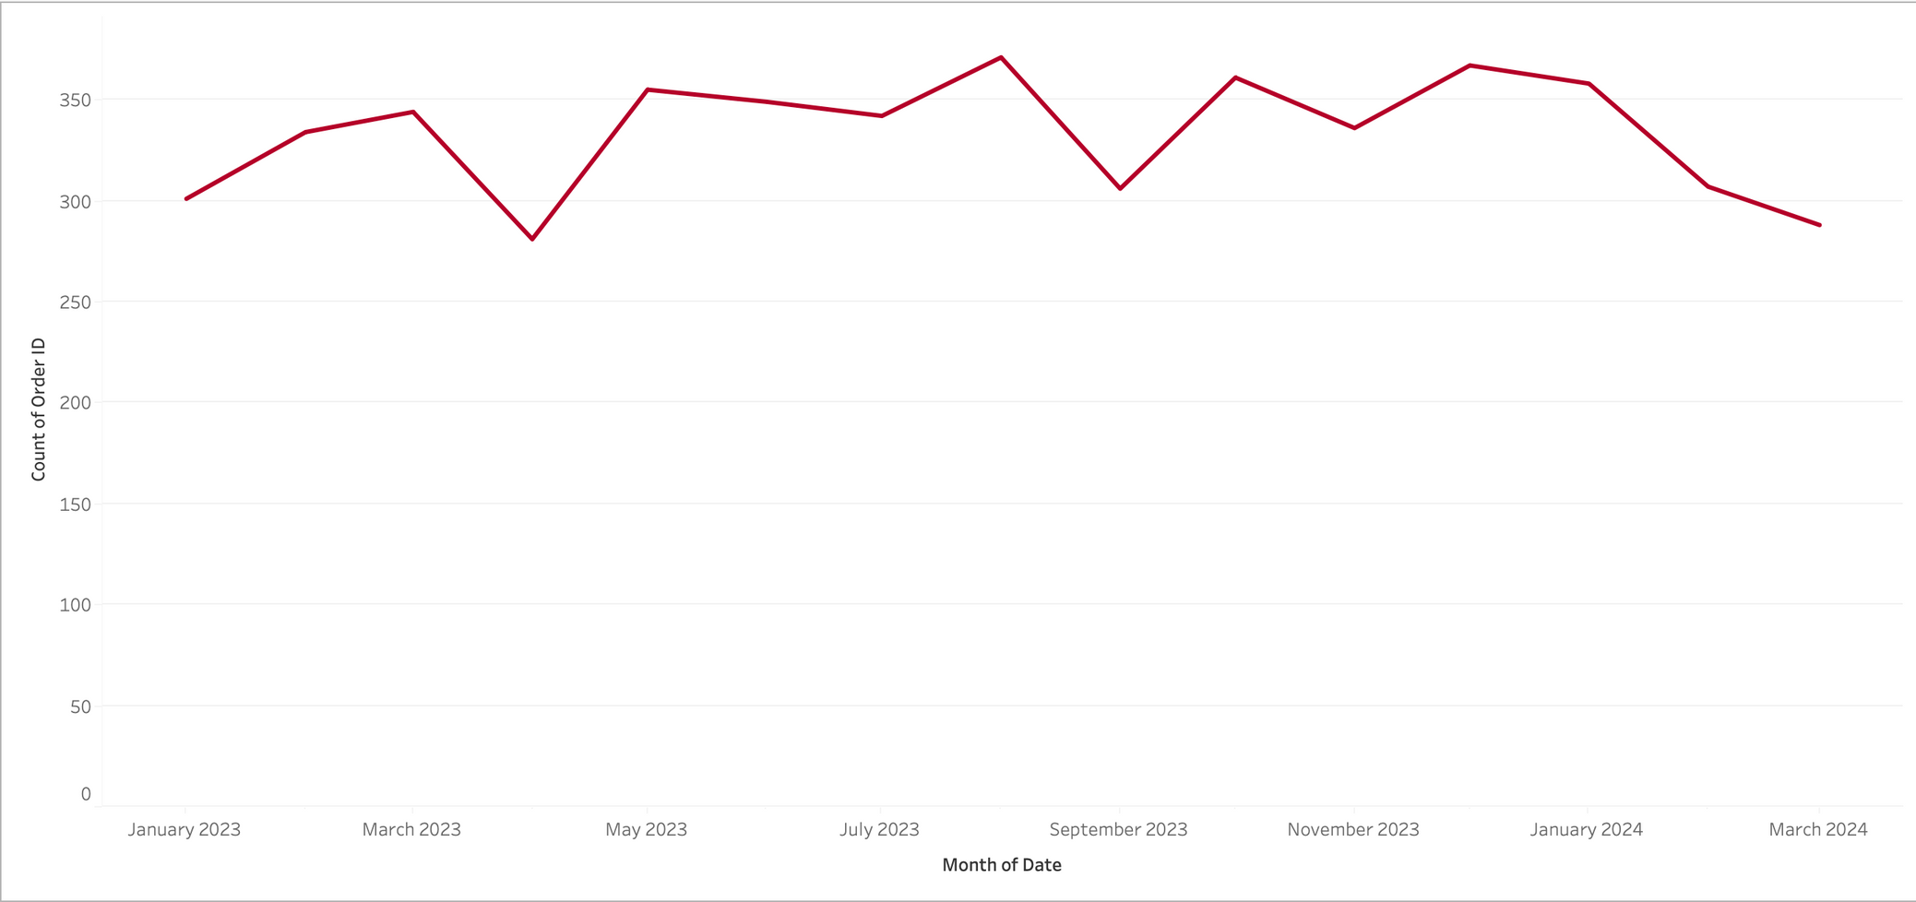
Is there a seasonal trend in total purchase amount?

Slide 3
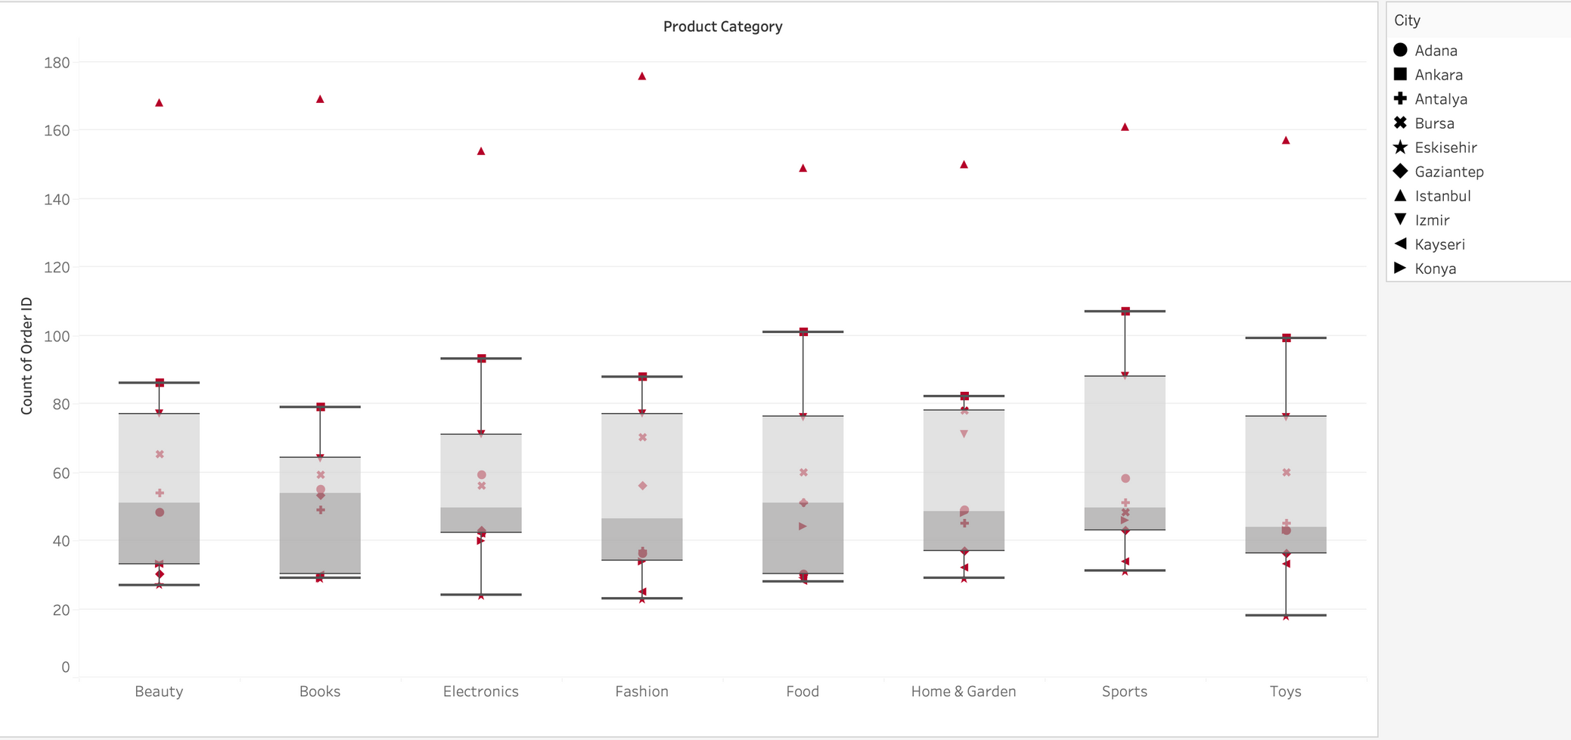
Is there a correlation between product categories and cities?

Slide 4

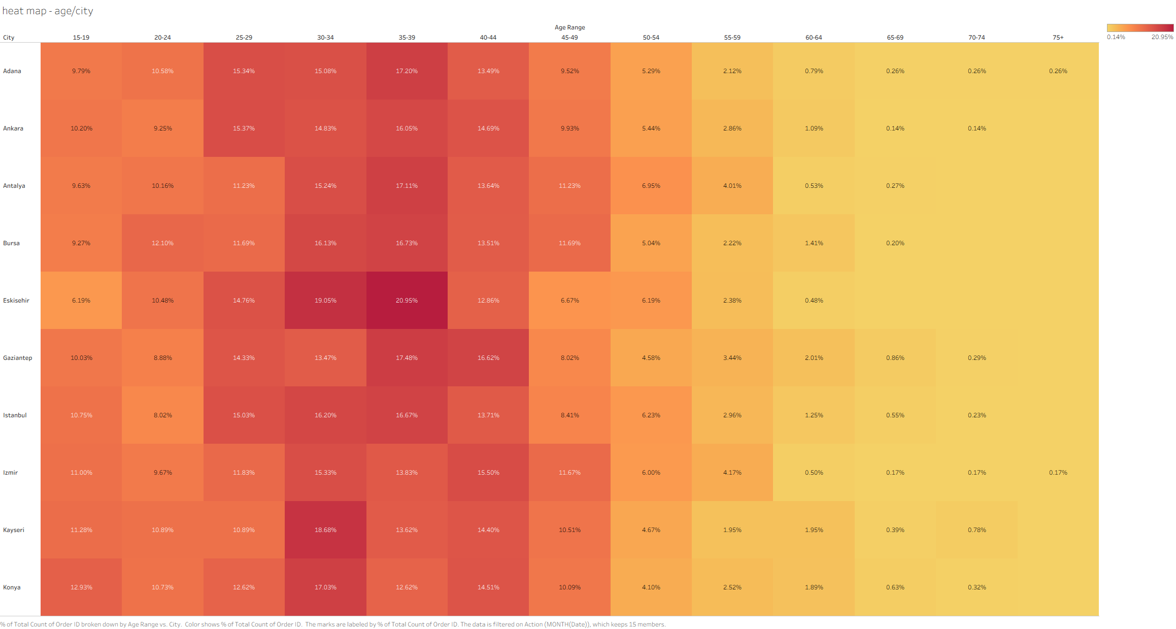

What is the age distribution of customers per city?
  demographic differences
  target audience
  city-based marketing strategies

Slide 5
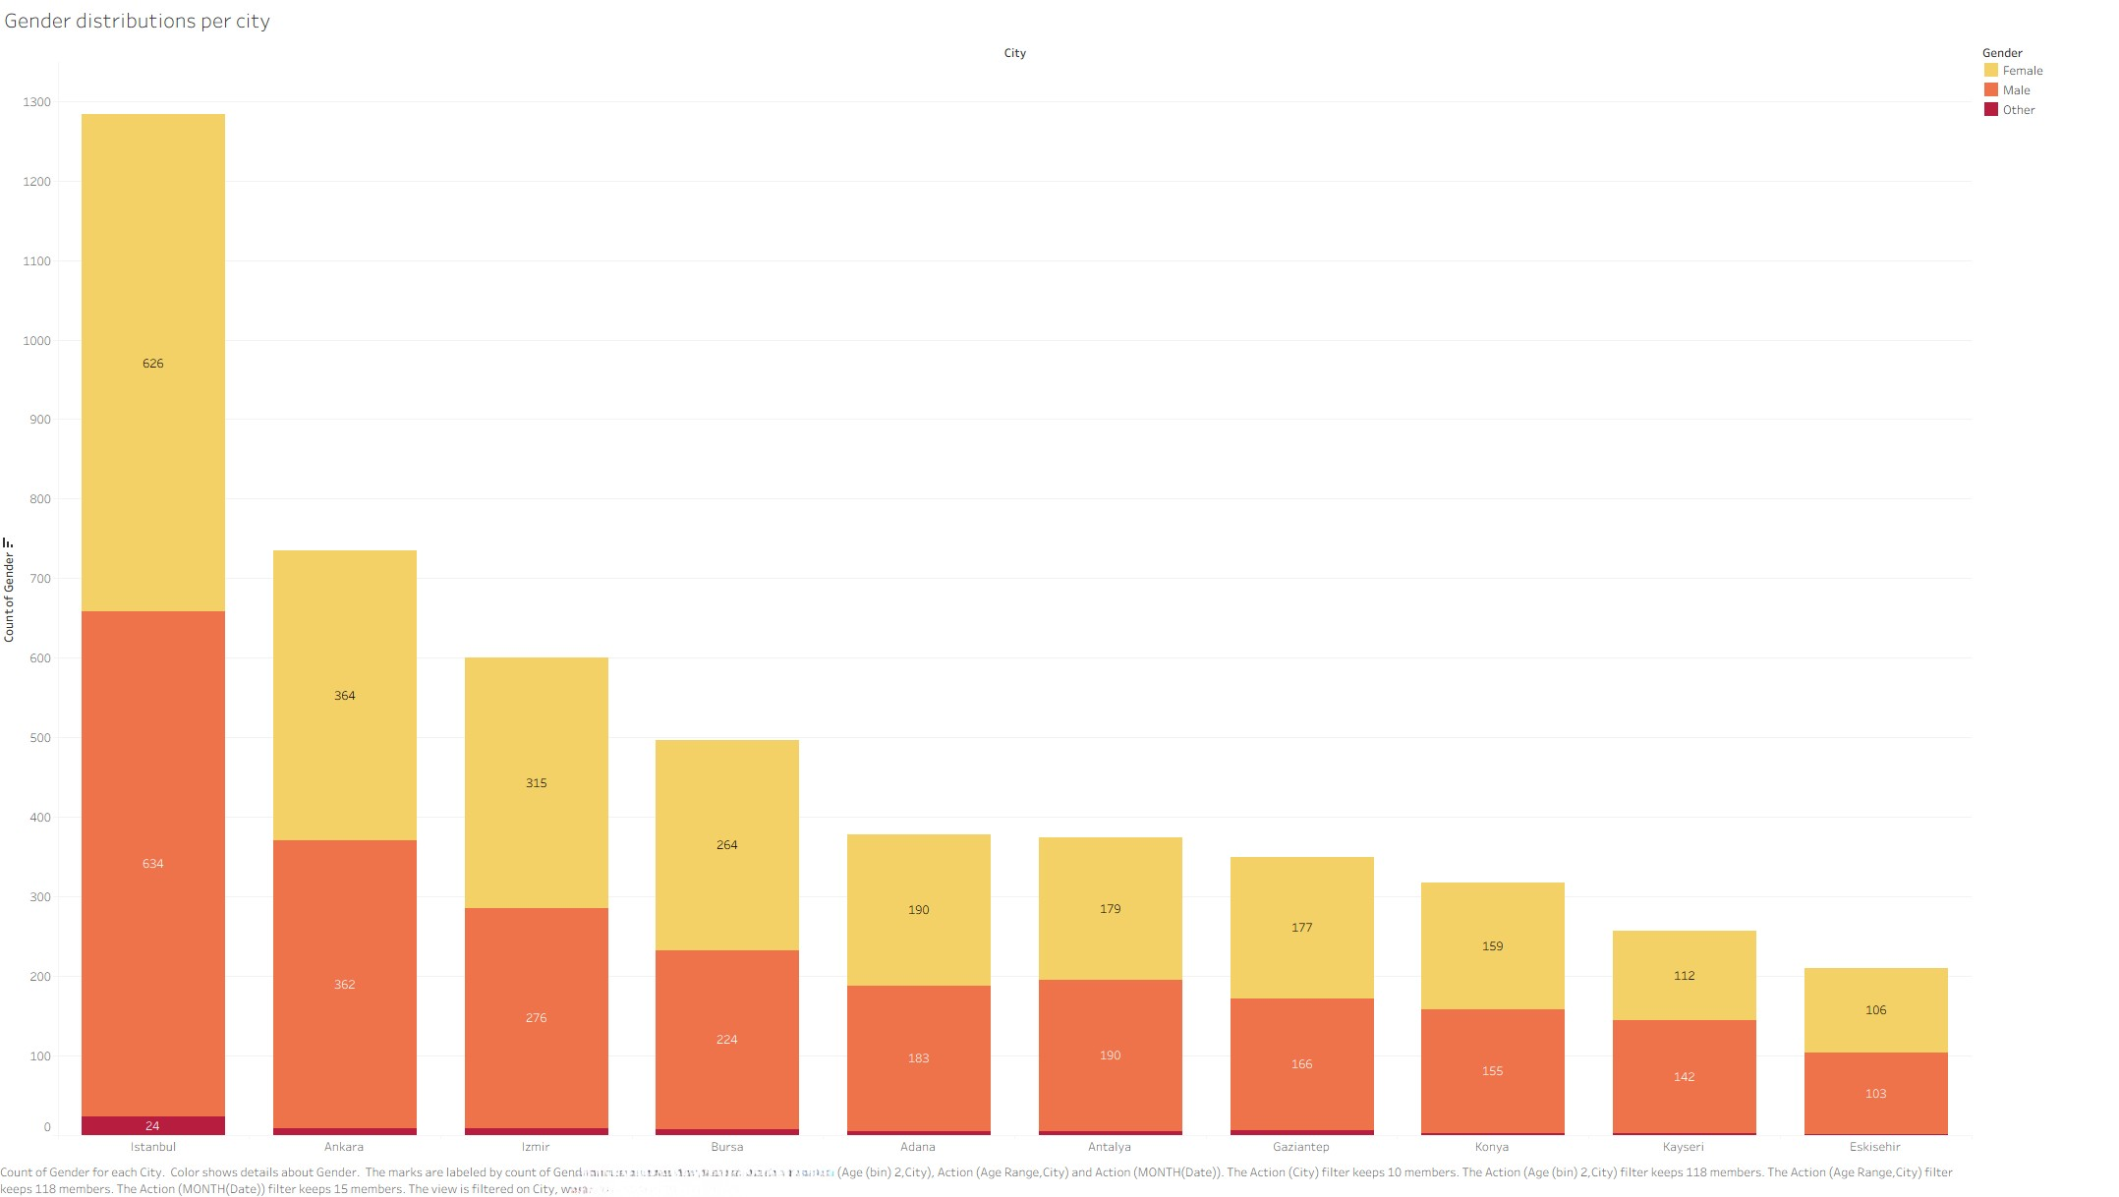


What is the gender distribution of customers per city?
  city-based product demand
  fundamental data for regional segmentation and personalization

Slide 6
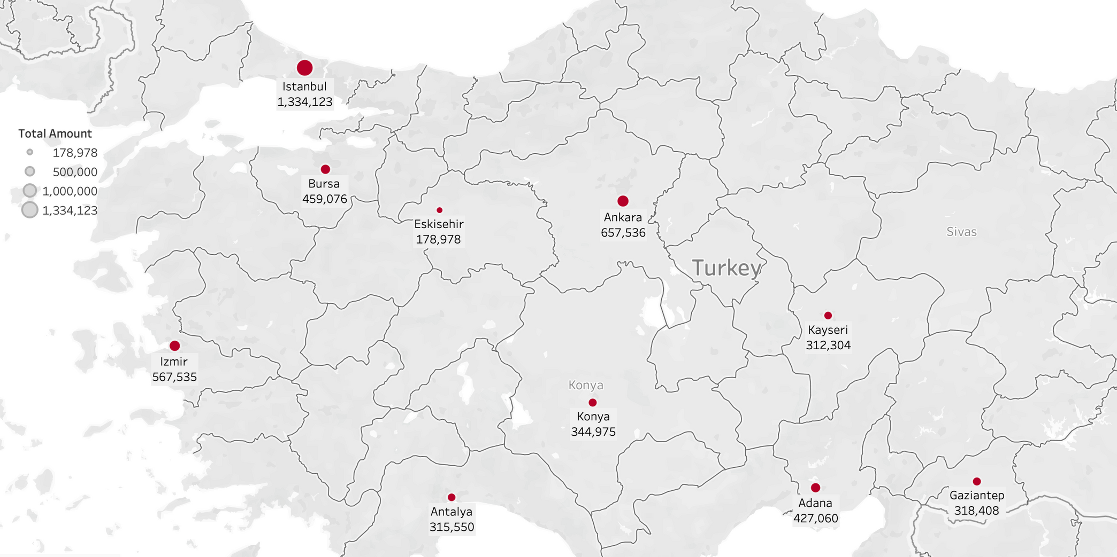
What is the geographic distribution of total amount across cities?

Slide 7
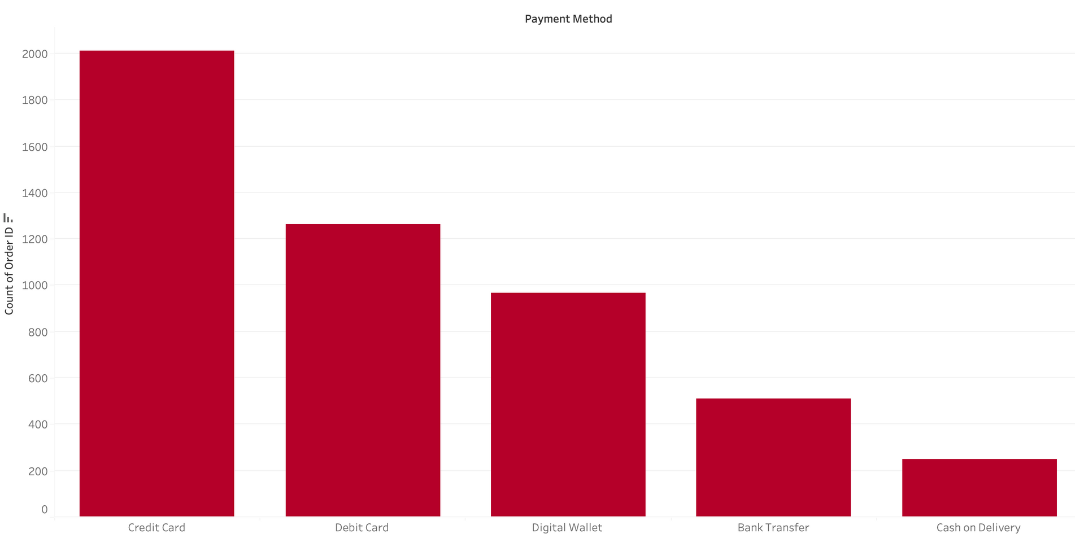
What is the distribution of orders by payment method ?

Slide 8
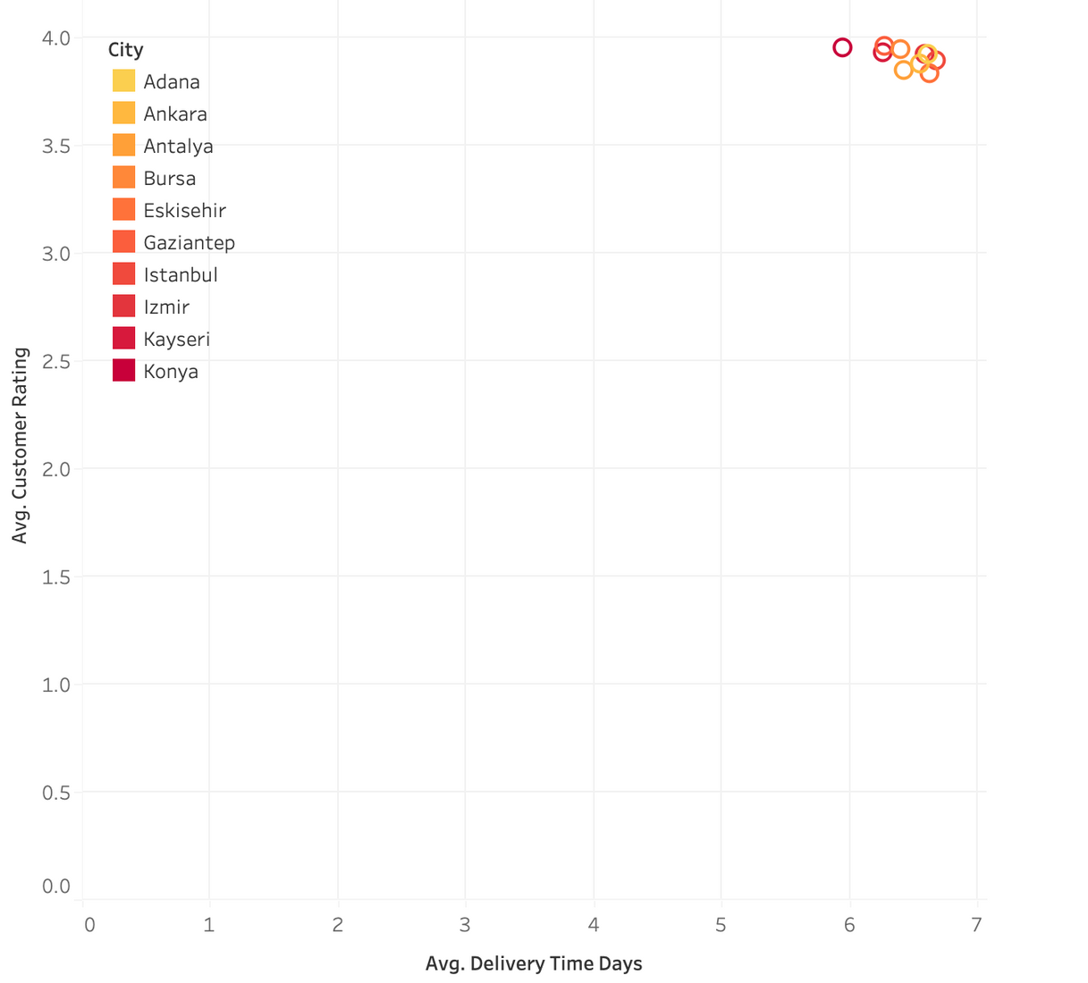

Is there a relationship
between delivery time
and customer ratings
across cities ?
  No correlation
  Uniform performance

Slide 9
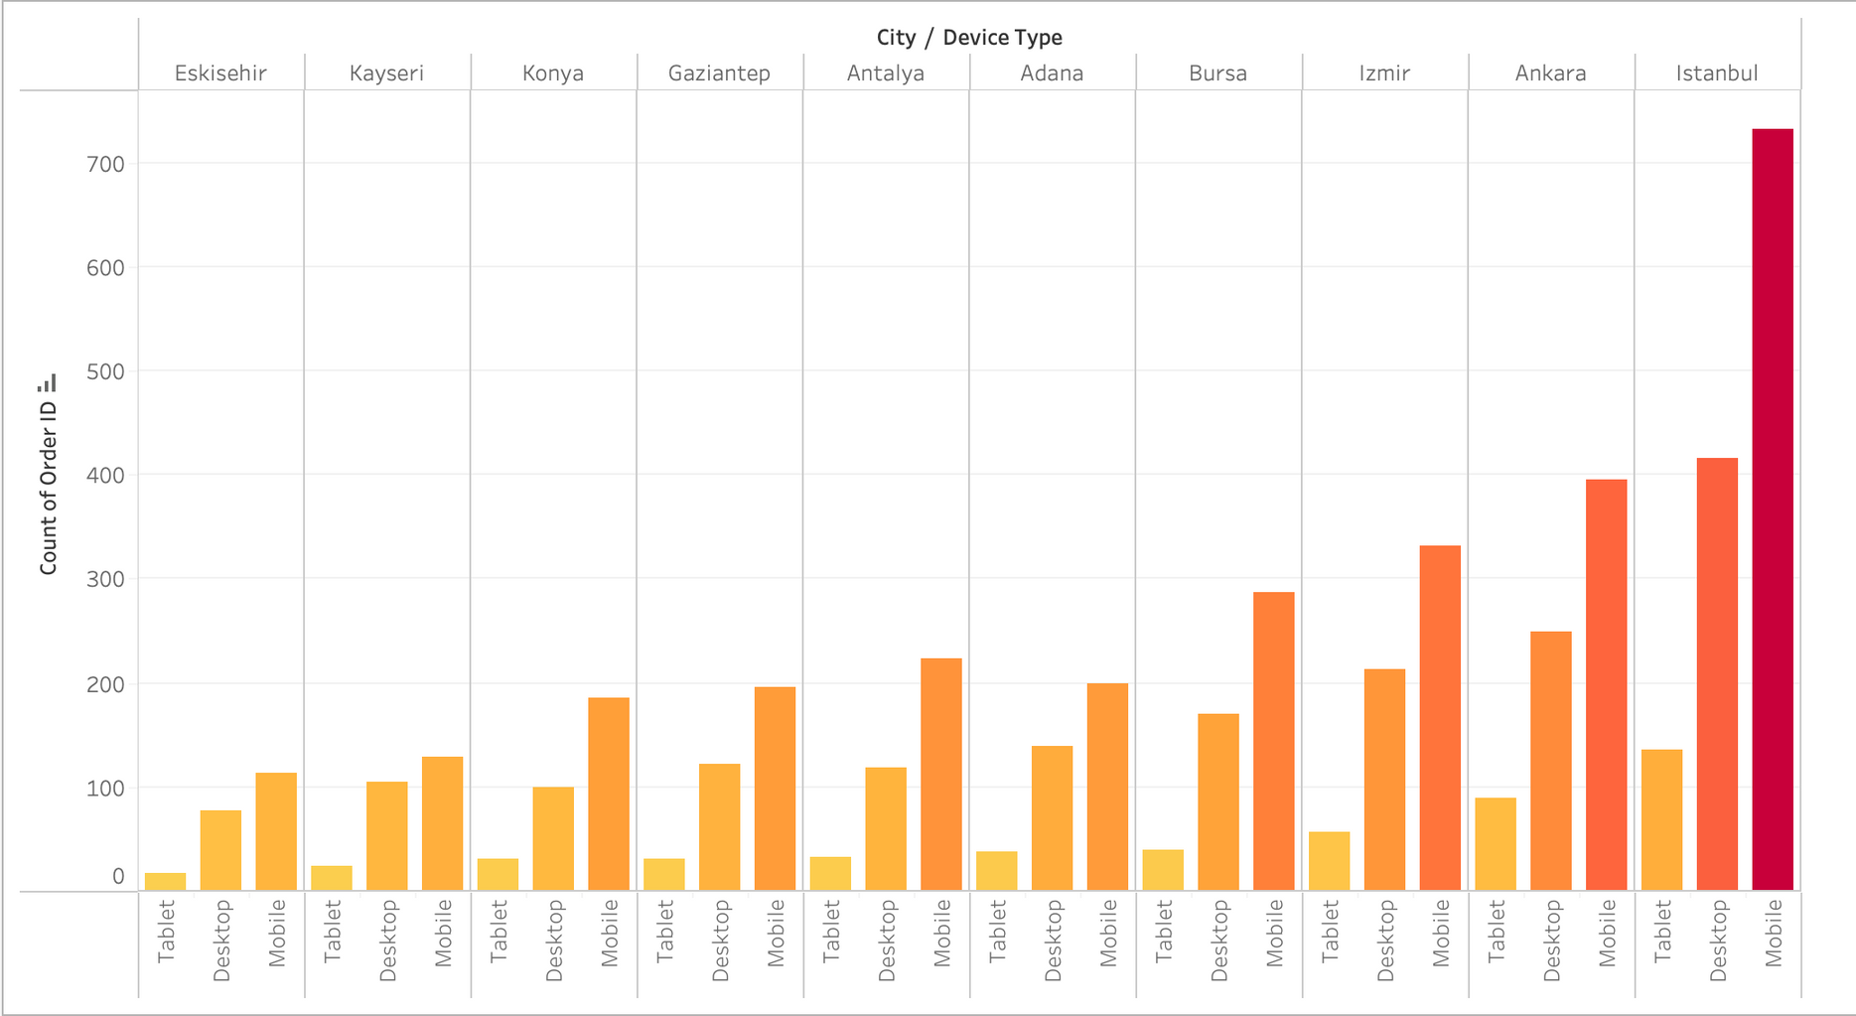

What is the distribution of orders by device type per city?

Slide 10

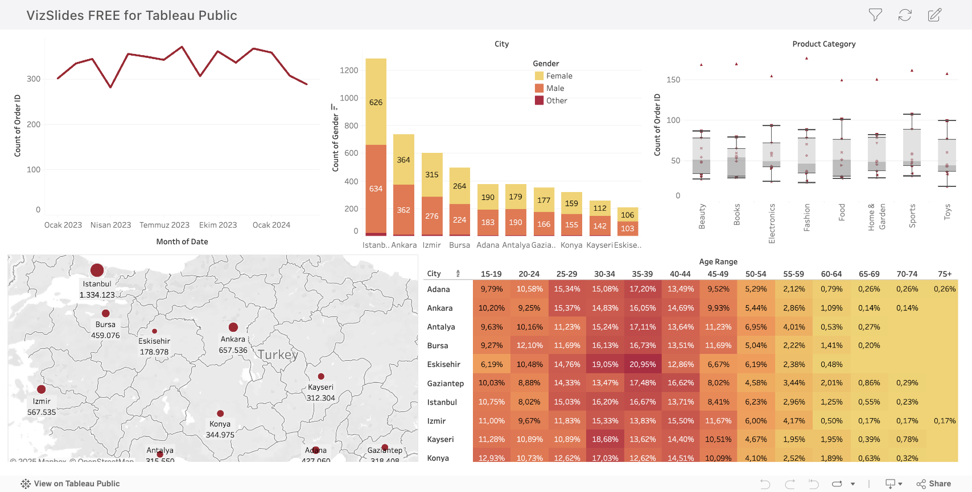
DASHBOARD

